Slide 1
Assignment 8 MORPHOLOGICAL OPERATION USING MATLAB
Mudit Dholakia
MT-006
Guide:-Prof. Tushar .V. Ratanpara

Slide 2
AIM 1
1) Write a program Which performs following morphological operations on images.
Erosion
Dilation
Opening
Closing
Hit or Miss Transformation

Slide 3
Code :- (EROISION-DIALATION)
clear all;
close all;
clc;
chs=input('PRESS 1. FOR EROSION:-2. FOR DILATION:-');
if chs==1
I=imread('erdl.tif');
SE1 = strel('diamond', 1);
SE2 = strel('square',33);
SE3 = strel('line',10,45);
SE4 = strel('disk',15);
SE5 = strel('rectangle',[10 10]);

Slide 4
Code:-(Cont’d)
eroded1 = imerode(I,SE1);
eroded2 = imerode(I,SE2);
eroded3 = imerode(I,SE3);
eroded4 = imerode(I,SE4);
eroded5 = imerode(I,SE5);
subplot(2,3,1);
imshow(I);title('ORIGINAL')
subplot(2,3,2);
imshow(eroded1);title('Diamond')
subplot(2,3,3);
imshow(eroded2);title('Square')
subplot(2,3,4);
imshow(eroded3);title('Line')

Slide 5
Code:-(Cont’d)
subplot(2,3,5);
imshow(eroded4);title('Disk')
subplot(2,3,6);
imshow(eroded5);title('Rectangle')
elseif chs==2
I=imread('erdl.tif');
SE1 = strel('diamond', 1);
SE2 = strel('square',33);
SE3 = strel('line',10,45);
SE4 = strel('disk',15);

Slide 6
Code:-(Cont’d)
SE5 = strel('rectangle',[10 10]);
dil1 = imdilate(I,SE1);
dil2 = imdilate(I,SE2);
dil3 = imdilate(I,SE3);
dil4 = imdilate(I,SE4);
dil5 = imdilate(I,SE5);
subplot(2,3,1);
imshow(I);title('ORIGINAL')
subplot(2,3,2);

Slide 7
Code:-(Cont’d)
imshow(dil1);title('Diamond')
subplot(2,3,3);
imshow(dil2);title('Square')
subplot(2,3,4);
imshow(dil3);title('Line')
subplot(2,3,5);
imshow(dil4);title('Disk')
subplot(2,3,6);
imshow(dil5);title('Rectangle')
end

Slide 10
Code:-(OPENING-CLOSING)
clear all;
close all;
clc;
chs=input('PRESS 1. FOR OPENING:-2. FOR CLOSING:-');
if chs==1
I=imread('erdl.tif');
s1=input('Enter StructuringElement for Erosion:1.diamond 2.square 3.lone 4.disk 5.rectangle::--');
if s1==1
SE = strel('diamond', 1);
elseif s1==2
SE = strel('square',33);
elseif s1==3
SE = strel('line',10,45);

Slide 11
Code:-(Cont’d)
elseif s1==4
SE = strel('disk',15);
elseif s1==5
SE = strel('rectangle',[10 10]);
end
eroded = imerode(I,SE);
s2=input('Enter StructuringElement for Dilation:1.diamond 2.square 3.lone 4.disk 5.rectangle::--');
if s2==1
SE = strel('diamond', 1);
elseif s2==2
SE = strel('square',33);
elseif s2==3
SE = strel('line',10,45);
elseif s2==4
SE = strel('disk',15);
elseif s2==5

Slide 12
Code:-(Cont’d)
SE = strel('rectangle',[10 10]);
end
dil = imdilate(eroded,SE);
subplot(1,3,1);
imshow(I);title('ORIGINAL')
subplot(1,3,2);
imshow(eroded);title('EROSION')
subplot(1,3,3);
imshow(dil);title('EROSION+DIALATION=OPENING')
elseif chs==2
I=imread('erdl.tif');
s1=input('Enter StructuringElement for Dilation:1.diamond 2.square 3.lone 4.disk 5.rectangle::--');
if s1==1
SE = strel('diamond', 1);

Slide 13
Code:-(Cont’d)
elseif s1==2
SE = strel('square',33);
elseif s1==3
SE = strel('line',10,45);
elseif s1==4
SE = strel('disk',15);
elseif s1==5
SE = strel('rectangle',[10 10]);
end
dil = imdilate(I,SE);
s2=input('Enter StructuringElement for Erosion:1.diamond 2.square 3.lone 4.disk 5.rectangle::--');
if s2==1
SE = strel('diamond', 1);
elseif s2==2

Slide 14
Code:-(Cont’d)
SE = strel('square',33);
elseif s2==3
SE = strel('line',10,45);
elseif s2==4
SE = strel('disk',15);
elseif s2==5
SE = strel('rectangle',[10 10]);
end
eroded = imerode(dil,SE);
subplot(1,3,1);
imshow(I);title('ORIGINAL')
subplot(1,3,2);
imshow(dil);title('DILATION')
subplot(1,3,3);
imshow(eroded);title('DIALATION+EROSION=OPENING')
end

Slide 17
AIM 2
Write a program for following applications of morphological operations for images.
Boundary extraction
Hole filling
Extraction of connected components
Convex hull (optional)
Skeletons (optional)
Thinning (optional)
Thickening (optional)

Slide 18
Code:- (BOUNDARY EXTRACTION)
A=imread('binaryimg.png');
s=strel('disk',2,0);
F=imerode(A,s);
figure,
subplot(2,1,1);
imshow(A);title('Binary Image');
subplot(2,1,2);
imshow(A-F);title('Boundary extracted Image');

Slide 19
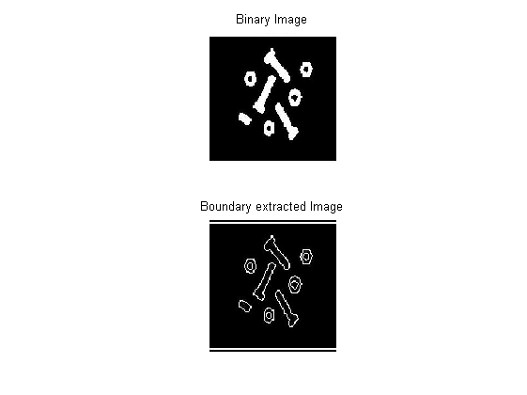

Slide 20
Code:- (HOLE FILLING)
clc;
close all;
clear all;
I=imread('hole.tif');
figure,imshow(I);
I = imcomplement(I);
sz=size(I);
I=I>128;
[a, b] = bwlabel(I,8);
ni=ones(sz(1),sz(2));

Slide 21
Code:- (Cont’d)
for i=1:sz(1)
for j=1:sz(2)
if a(i,j)>0
ni(i,j)=1;
else
ni(i,j)=0;
end
end
end

Slide 22
Code:- (Cont’d)
for i=1:sz(1)
for j=1:sz(2)
if a(i,j)>1
ni(i,j)=1;
else
ni(i,j)=0;
end
end
end

Slide 23
Code:- (Cont’d)
I=imcomplement(I);
for i=1:sz(1)
for j=1:sz(2)
if ni(i,j)>0
I(i,j)=I(i,j)+ni(i,j);
end
end
end
figure,imshow(ni);
figure,imshow(I);

Slide 25
Code:- (Extraction of connected components)
clc;
close all;
clear all;
I=imread('mob2.jpg');
I = rgb2gray(I);
figure,imshow(I);
I = imcomplement(I);
sz=size(I);
I=I>128;
[a, b] = bwlabel(I,8);

Slide 26
Code:- (Cont’d)
for i=1:sz(1)
for j=1:sz(2)
if a(i,j)>0
ni(i,j)=1;
else
ni(i,j)=0;
end
end
end
figure,imshow(ni);

Slide 27
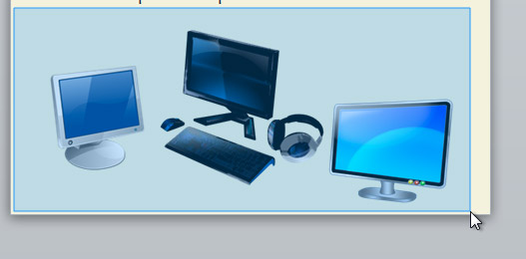
Output Image
Input Image

Slide 28
THANK YOU

